Slide 1
Why don't we learn about Fred Hampton?
Student health & human services
Office of human relations, diversity & equity
July 2022
Notes:
Dear teacher, thank you for choosing to share this Advisory Lesson with your class. The Office of Human Relations, Diversity & Equity wants to remind all educators of the importance of teaching Black History all year long. February is a month to celebrate, amplify and recognize Black history. But students must understand that Black history is world history, and should be taught as such. ​
​
Additionally, please remind students of classroom norms as you move forward with this lesson.

Slide 2
Would you rather...
BE THE SMARTEST PERSON AT SCHOOL
BE THE MOST POPULAR PERSON AT SCHOOL
Notes:
Please engage the students in a brief check in.

Slide 3
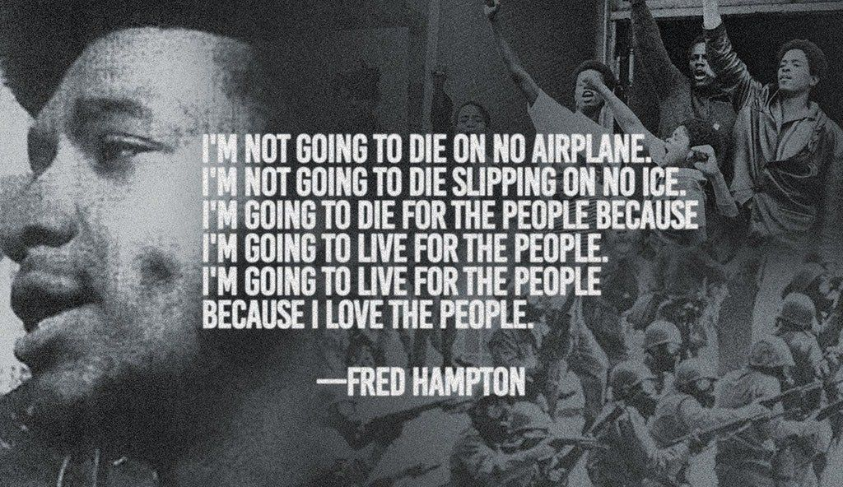
Notes:
Read the slide aloud for your students.

Slide 4
objectives
Learn about the life of Frederick Hampton
Learn about his activism
Discuss his beliefs and involvements towards social change
Notes:
Read the objectives aloud for your students. Remind students of classroom norms.

Slide 5
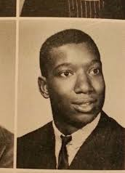
FREDERICK ALLEN HAMPTON early life
Fred Hampton grew up in the greater chicagoland area
He was an honors student and an athlete.
Fred had dreams of playing center field for the new york yankees, or becoming a lawyer.
He had a lot of exposure to police brutality in the black community, as it was a part of the everyday fabric of his life.
Notes:
Read the slide aloud for your students.

Slide 6
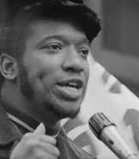
Activism
Fred Hampton was known as a black activist & revolutionary socialist
He became well-known in chicago as chairman of the illinois chapter of the black panther party (BPP), and deputy chairman of the national BPP
Fred founded the rainbow coalition, a prominent multicultural political organization that initially included the Black Panthers, young patriots, and the Young Lords.
He also created an alliance among major Chicago street gangs to help end infighting and work towards social change.
Notes:
Read the slide aloud for your students.

Slide 7
Time to share
Fred Hampton did a lot of work in the Chicago community to bring peace and justice for marginalized people, during the civil rights movement.
Why do you think we don't learn about Fred Hampton in history class?
Notes:
Invite students to engage in reflection question.

Slide 8
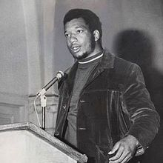
A radical threat?
at just 19 years old, Fred Hampton was identified by the FBI as a radical threat
The FBI tried to destroy his activities in Chicago by giving disinformation to black progressive groups .
They even placed a counterintelligence operative in the local black panthers.
Notes:
Read the slide aloud for your students.

Slide 9
Time to share
Fred Hampton was identified by the fbi as a radical threat for his activism.
DO YOU THINK HAMPTON SHOULD HAVE BEEN LABELED A THREAT?
Have you ever been negatively labeled unfairly?
Notes:
Invite students to engage in reflection question.

Slide 10
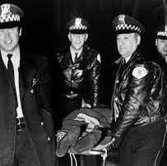
His death
Two years after the fbi declared hampton a radical threat they conducted a pre-dawn raid at his chicago apartment.
the tactical team included the cook county state's attorneys office, chicago police, and the fbi
During the raid, mark clark, a fellow panther and fred hampton were killed and several others were injured
Fred was 21 years old.
Notes:
Read the slide aloud for your students.

Slide 11
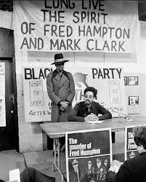
The aftermath
A civil lawsuit was filed on behalf of the survivors and the relatives of Hampton and Clark.
in 1982 a settlement of $1.85 million was reached.
the City of Chicago, Cook County, and the federal government each paid one-third to a group of nine plaintiffs.
Given revelations about the illegal COINTELPRO program and documents associated with the killings, many scholars now consider Hampton's death an assassination under the FBI's initiative.

Slide 12
i am a revolutionary!
Notes:
Play the video for the students (5:14)
https://www.youtube.com/watch?v=d1Pbs2TRRlg&feature=emb_title

Slide 13
Time to share
In the video, hampton talks about fighting fire with water and talks about people of all races joining together for this cause.
He also worked with several different gangs to create an alliance among them to create social change.
Why do you think he was so adamant about bringing people together?
Notes:
Invite students to engage in reflection question.

Slide 14
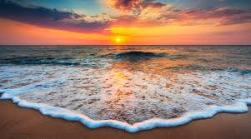
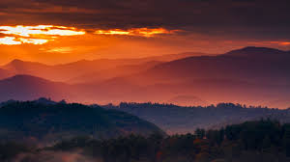
Which is better?
MOUNTAINS AT SUNSET
OCEAN AT SUNSET
Notes:
Engage students in check out question

Slide 15
Teacher Feedback
Notes:
Teacher, please complete the brief feedback survey by scanning the QR code or using the link below
https://forms.office.com/r/i9UqyyxzTT

Slide 16
Human Relations, Diversity & Equity

